Slide 1

SPI Master (Mode-0) Implementation
A synchronous serial communication protocol implementation for embedded systems, developed by student team
2023-EE-173 2023-EE-181
2023-EE-185 2023-EE-167.

Slide 2
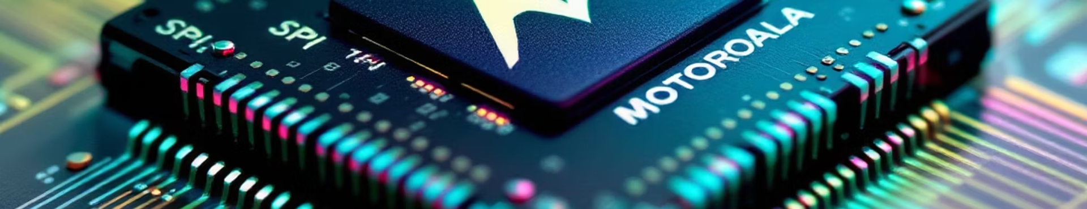



Introduction to SPI
Serial Peripheral Interface
Historical Context
Wide Application
Developed by Motorola in the mid-1980s.
Widely used in modern embedded systems for device communication.
A synchronous serial communication protocol for embedded systems.

Slide 3

Literature Review
1
Design and Implementation of SPI Master Slave Using Verilog HDL
IEEE Conference, 2019. Focused on efficient state machine design and resource optimization.
2
FPGA-Based Implementation of SPI Communication Protocol
International Journal, 2020. Emphasized timing optimization and FPGA-specific considerations.
3
High-Speed SPI Master Controller Design
IEEE Transactions on VLSI Systems. Featured multiple slave support and clock management techniques.

Slide 4
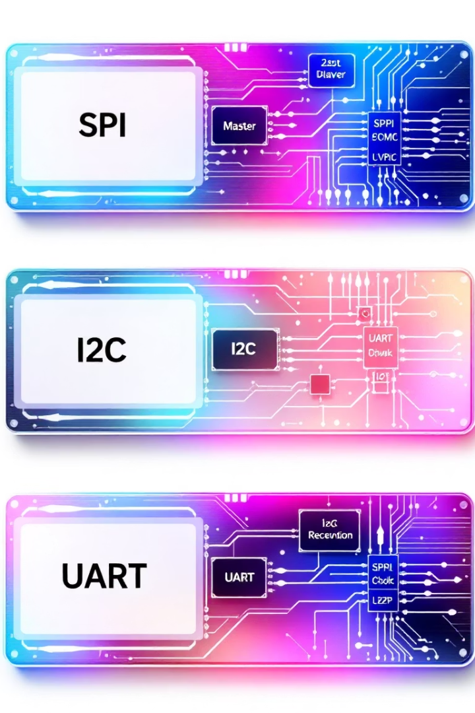
Why SPI?
Simple Hardware Implementation
Full-duplex communication
No complex addressing
Minimal pin requirements
Wide Industry Support
Sensors and memory devices
Display controllers
ADCs/DACs

Slide 5
Project Specifications
Hardware Target
Clock Specifications
Xilinx Artix-7 FPGA
System clock: 100 MHz
SystemVerilog implementation
SPI clock: 25 MHz
8-bit data width
Configurable division ratio
Mode-0 operation

Slide 6



Interface Specifications
Input Signals
Output Signals
clk (System clock)
mosi (Master Out Slave In)
rst_n (Active-low reset)
start (Start transmission)
sclk (Serial Clock)
cs_n (Chip Select)
data_in (8-bit data)
busy/done (Status signals)

Slide 7








Timing Specifications
Setup Time
Hold Time
2ns minimum before clock edge
1ns minimum after clock edge
Clock Characteristics
CPOL = 0 (Clock idles low)
CPHA = 0 (Sample on rising edge)
Clock to Output
5ns maximum delay

Slide 8






Design Architecture
Control Logic
State machine and timing control
Data Path
Shift register and bit counter
Interface
Signal drivers and receivers
The SPI Master connects data_in, start, clk, and rst_n inputs to mosi, sclk, cs_n, busy, and done outputs through a structured architecture.

Slide 9








State Machine
IDLE
LOAD
Wait for start signal
Load data into shift register
COMPLETE
TRANSFER
Signal done and return to IDLE
Send bits serially

Slide 10




Verification Plan
Test Cases
Basic data transfer
Reset during transfer
Back-to-back transfers
Error conditions
Coverage Goals
100% state coverage
100% transition coverage
Signal toggle coverage
Verification Environment
SystemVerilog testbench
Self-checking assertions
Automated regression tests

